Slide 1
웹개발 강의

Slide 2
1. 필수프로그램
파이참프로 다운로드 링크
https://www.jetbrains.com/pycharm/download/
젯브레인 회원가입 링크
https://account.jetbrains.com/login
AWS회원가입 링크
https://portal.aws.amazon.com/billing/signup#/start

Slide 3
1-1 구글폰트
https://fonts.google.com/?subset=korean

Slide 4
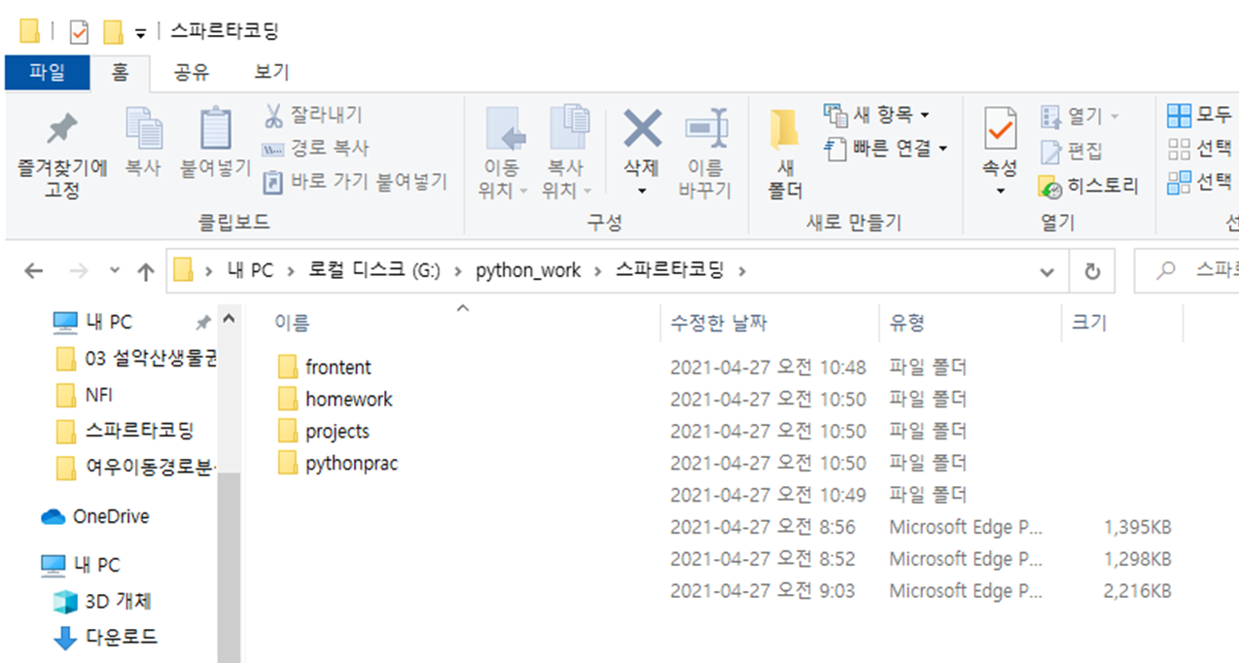
1-1 파이참 실습 폴더 구조

Slide 5
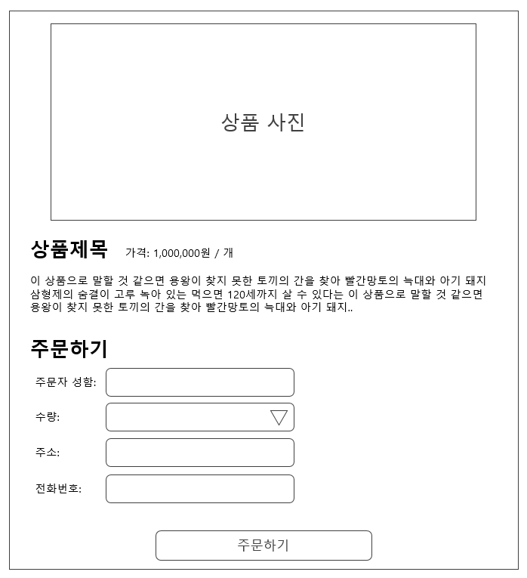
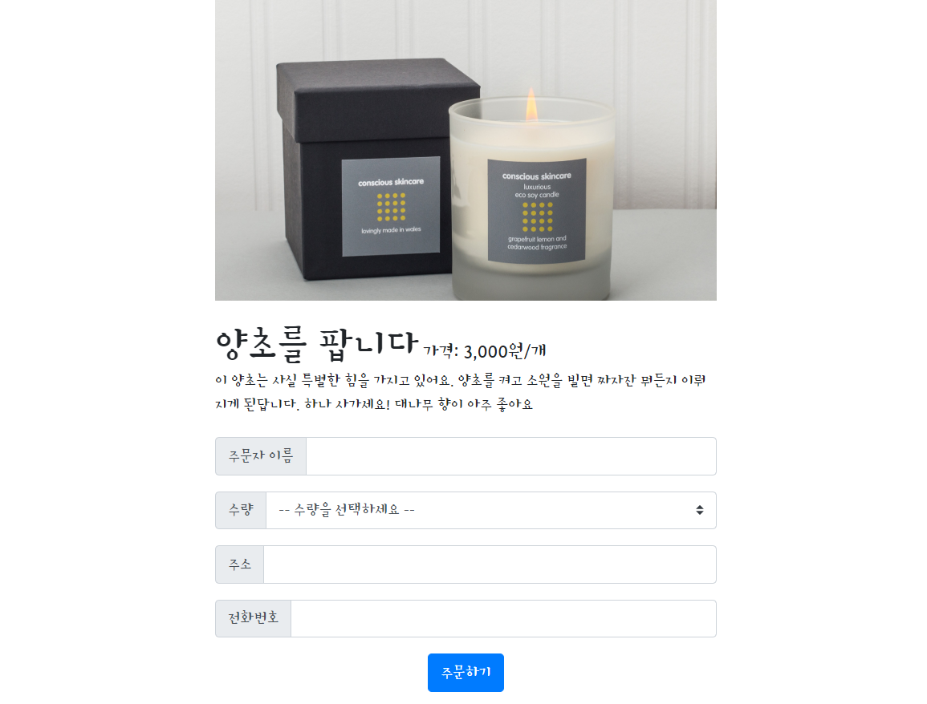
2. 1주차 과제

Slide 6
2-1.부트스트랩시작 템플릿
<!doctype html>
<html lang="en">
<head>
<!-- Required meta tags -->
<meta charset="utf-8">
<meta name="viewport" content="width=device-width, initial-scale=1, shrink-to-fit=no">
<!-- Bootstrap CSS -->
<link rel="stylesheet" href="https://maxcdn.bootstrapcdn.com/bootstrap/4.0.0/css/bootstrap.min.css"
integrity="sha384-Gn5384xqQ1aoWXA+058RXPxPg6fy4IWvTNh0E263XmFcJlSAwiGgFAW/dAiS6JXm" crossorigin="anonymous">
<!-- Optional JavaScript -->
<!-- jQuery first, then Popper.js, then Bootstrap JS -->
<script src="https://ajax.googleapis.com/ajax/libs/jquery/3.5.1/jquery.min.js"></script>
<script src="https://cdnjs.cloudflare.com/ajax/libs/popper.js/1.12.9/umd/popper.min.js"
integrity="sha384-ApNbgh9B+Y1QKtv3Rn7W3mgPxhU9K/ScQsAP7hUibX39j7fakFPskvXusvfa0b4Q"
crossorigin="anonymous"></script>
<script src="https://maxcdn.bootstrapcdn.com/bootstrap/4.0.0/js/bootstrap.min.js"
integrity="sha384-JZR6Spejh4U02d8jOt6vLEHfe/JQGiRRSQQxSfFWpi1MquVdAyjUar5+76PVCmYl"
crossorigin="anonymous"></script>
<title>스파르타코딩클럽 | 부트스트랩 연습하기</title>
</head>
<body>
<h1>이걸로 시작해보죠!</h1>
</body>
</html>

Slide 7
2-2부트스트랩 컴포넌트
https://getbootstrap.com/docs/4.0/components/alerts/

Slide 8
2-3. 1주차 과제 답압 코드

